Slide 1
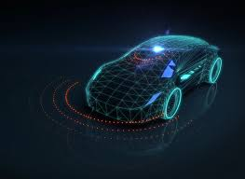
VEHICLE MOVEMENT ANALYSIS USING EDGE AI ON A COLLEGE CAMPUS
Team Member:
Anagha Challa
Sukanya
Anjali S. Kumari

Slide 2
PROBLEM STATEMENT
Managing vehicle movement within a college campus involves optimizing traffic flow, ensuring safety, and efficiently utilizing parking spaces. The goal is to develop a real-time system to analyze vehicle movements, providing insights to improve traffic management, enhance safety, and optimize parking space usage.
Objectives:
Optimize vehicle traffic flow within the campus.
Enhance safety by monitoring and identifying risky driving behaviors.
Improve parking management by monitoring occupancy and availability.
Generate actionable insights for infrastructure planning and management.

Slide 3
UNIQUE IDEA BRIEF
Real-time vehicle movement analysis using video and sensor data: Utilize high-resolution video feeds and sensor data to monitor vehicle movements across the campus in real-time. This allows for the continuous tracking of vehicle flow, identifying patterns and potential issues as they occur.
Detect and monitor risky driving behaviors: Implement advanced algorithms to identify risky driving behaviors, such as speeding, sudden stops, and erratic driving. This enhances safety by allowing for immediate intervention and long-term planning to mitigate such behaviors.

Slide 4
Cont'd
Optimize parking management by tracking occupancy: Use sensor data to monitor the occupancy and availability of parking spaces. This helps in optimizing parking space usage, reducing congestion, and improving the overall parking experience for users.
Provide actionable insights for infrastructure planning: Generate detailed reports and insights from the collected data to inform infrastructure planning and management. These insights can guide decisions on traffic management, safety improvements, and future campus development projects.

Slide 5
FEATURES OFFERED
Real-time traffic flow analysis:
Continuously monitors vehicle movements to identify traffic patterns and predict
congestion, enabling immediate adjustments for smooth traffic flow.
Safety enhancement through risky behavior detection:
Uses AI to detect dangerous driving behaviors (e.g., speeding, abrupt lane changes)
and sends alerts to authorities, enhancing campus safety.

Slide 6
Cont'd
Parking space optimization:
Tracks real-time parking availability and provides recommendations for efficient parking space
usage, reducing search time for drivers.
Infrastructure planning insights:
Analyzes data on vehicle movement and parking usage to provide insights for better
road networks and parking facilities, ensuring data-driven infrastructure development.

Slide 7
PROCESS FLOW
Data Collection:
Collects video feeds and sensor data from strategic campus locations to
monitor vehicle movements.
Data Pre-processing:
Extracts and preprocesses video frames to prepare data for further analysis.
Model Training:
Uses AI techniques for object detection and vehicle tracking to recognize and
monitor vehicles.

Slide 8
Cont'd
Analysis:
Analyzes data to provide insights on traffic flow, parking utilization,
and safety conditions.
Deployment:
Implements the AI solution on edge devices for real-time data processing and
immediate insights.

Slide 9
TECHNOLOGIES USED
Data Acquisition:
Utilizes cameras, LIDAR, and ultrasonic sensors strategically placed across the campus.
These devices capture high-resolution video feeds and precise sensor data.
This data is essential for monitoring vehicle movements and collecting accurate measurements.
Data Preparation:
Uses OpenCV for extracting and preprocessing video frames from the collected feeds.
Pandas is employed for data cleaning and organizing sensor data for analysis.
This step ensures the data is in a usable format for subsequent processes.

Slide 10
Model Development:
Implements TensorFlow to train models for object detection and vehicle tracking.
These models identify and monitor vehicle movements within the campus.
The training process involves using labeled datasets to improve accuracy.
System Deployment:
Deploys the trained models on Jetson Nano devices for edge AI processing.
Edge AI techniques allow for real-time data processing directly on the devices.
This reduces latency and enables immediate insights and actions.
Analytical Tools:
Matplotlib is used to create visual representations of traffic flow and parking utilization.
Seaborn is employed for generating heatmaps and safety insights.
These tools help in understanding patterns and making data-driven decisions.

Slide 11
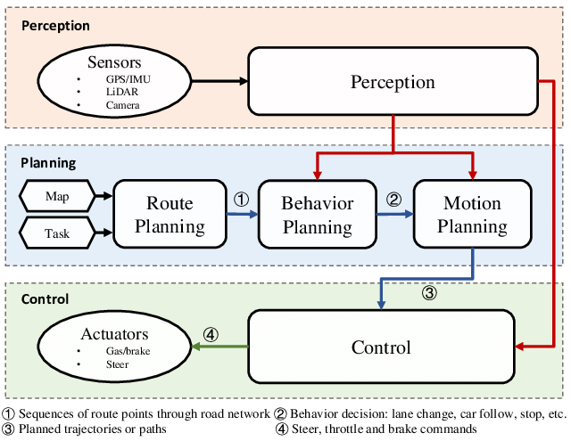
ARCHITECTURE DIAGRAM

Slide 12
TEAM MEMBERS AND CONTRIBUTION:
Member 1: Data Collection and Preprocessing
Managed real-time data collection and preprocessing from campus CCTV, sensors, and GPS.
Developed algorithms for traffic flow analysis and anomaly detection.
Member 2: Model Training and Analysis
Developed ML models to predict traffic patterns and identify risky driving behaviors.
Conducted statistical analysis for insights on vehicle movement and behavior trends.
Member 3: Deployment, Edge AI, and Visualization
Designed scalable system architecture for real-time data processing.
Implemented edge AI for quick decision-making and develop visualizations for insights.

Slide 13
CONCLUSION
This project demonstrates the effective use of edge AI for real-time vehicle movement analysis on a college campus. By utilizing cameras, LIDAR, and ultrasonic sensors, the system collects and processes high-resolution data for accurate object detection and vehicle tracking. Key outcomes include identifying peak traffic hours, optimizing parking utilization, and enhancing safety through the detection of risky driving behaviors. Future work involves integrating additional data sources and expanding coverage for comprehensive analysis, further optimizing traffic management, safety, and infrastructure planning.

